Slide 1
Chest Pain in the ED
Dr Davy Green

Slide 2
Causes?

Slide 3
Causes?
Cardiac
Respiratory
GI
MSK

Slide 4
Causes
Cardiac:
  ACS, aortic dissection, pericarditis, myocarditis, cornoary artery spasm, pulmonary embolism
Pulmonary:
  Pneumothorax, pneumonia / pleurisy
GI:
  Dyspepsia / GORD / PUD, oesophageal perforation (Boerhaave’s), pancreatitis, cholecystitis
Musculoskeletal:
  Costrochondritis, muscular chest pain

Slide 5
Mr A
67 yr old
30 mins central crushing chest pain at rest, eased with GTN spray
Pain free now

Slide 6
Further information …
PMHx: smoker, BMI 30, gout
Meds: diclofenac for gout
FMHx: father MI aged 60
Obs: P 70 BP 140/90 RR 16 SaO2 97%

Slide 7
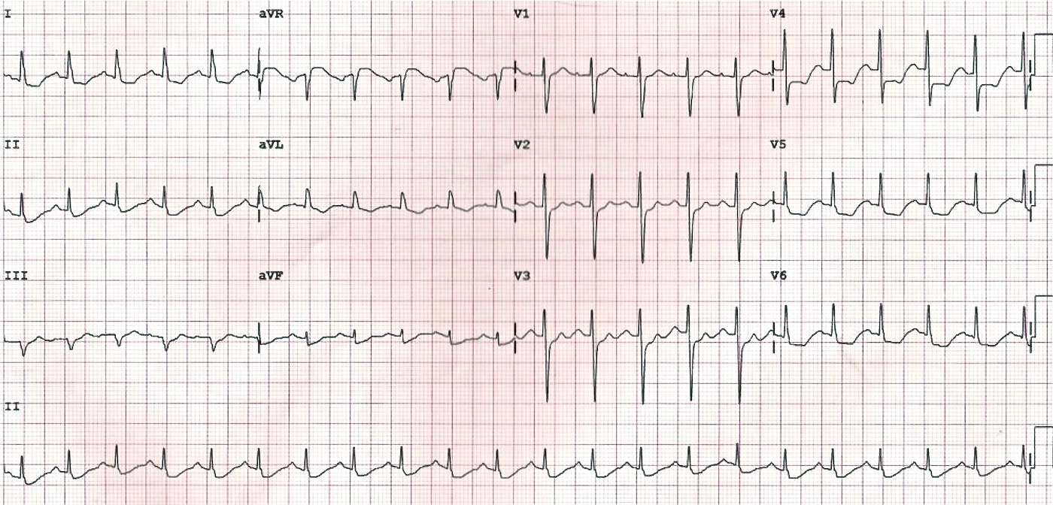
ECG

Slide 8
Diagnosis ?

Slide 9
Subendocardial Infarct (NSTEMI)

Slide 10
ED Management
Refer cardiology
Continuous cardiac monitoring
  VF and pulseless VT common in ACS
High flow O₂ via NRRM
  If SpO₂ < 94% with no risk of hypercapnic respirtory failure
Bloods
  FBP, U+E, blood glucose, troponin
Chest xray

Slide 11
ED management
Aspirin 300mg
  if not allergic AND not already on aspirin/clopidogrel
Analgesia
  GTN spray 2 puffs S/L,
    repeat after 4 mins if necessary
  Diamorphine titrate up to 5mg iv
    +/- metoclopramide 10mg iv
Enoxaparin approx 1mg/kg SC BD
  Reduce in renal failure and elderly

Slide 12
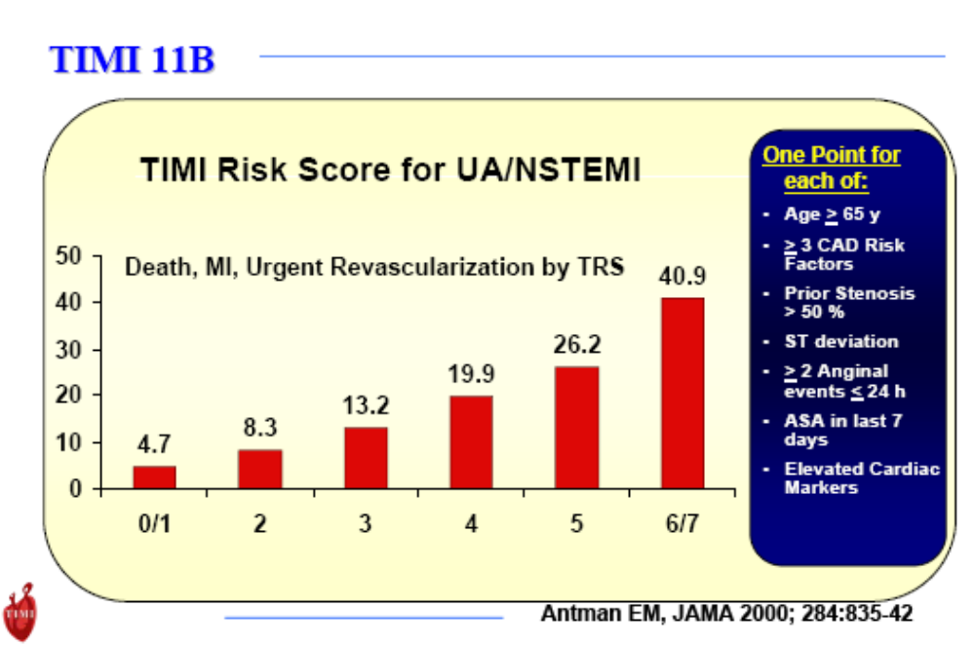
Low Risk Chest Pain
Notes:
Thrombolysis in myocardial infarction
Risk of death / MI within 14 days
Score 0 – 2 : 3% risk
Score 4 : 7% risk
Score 6 – 7 : 19% risk

Slide 13
Chest pain suggestive of cardiac origin
Pain free
ECG – no acute changes
TIMI score ≤ 2
Troponin at triage or initial doctor assessment
Initial troponin ≤ 14 and ≥ 4 hours from onset of pain
Initial troponin ≤ 14 and < 4 hours from onset of pain
Initial troponin ≥ 14
Repeat ECG – no acute changes*
Repeat troponin in 3 hours
Absolute$ troponin change ≤ 9 ng/L
Absolute$ troponin change of > 9 ng/L
Not consistent with AMI.
Consider discharge and outpatient
follow-up
Possible AMI, refer to cardiology

Slide 14
TIMI Scoring
Age>65
More than 3 risk factors
Enzymes raised
Recurrent episodes
Ischaemic changes on ECG
Coronary Artery Stenosis >50%
Aspirin in last 7/7

Slide 15
Admission Criteria
Cardiology
  Pain typical of angina that is
    1. new onset within preceding 5/7 or
    2. at rest within preceding 5/7 or
    Crescendo angina
SSW
  Follow low risk chest pain pathway

Slide 16
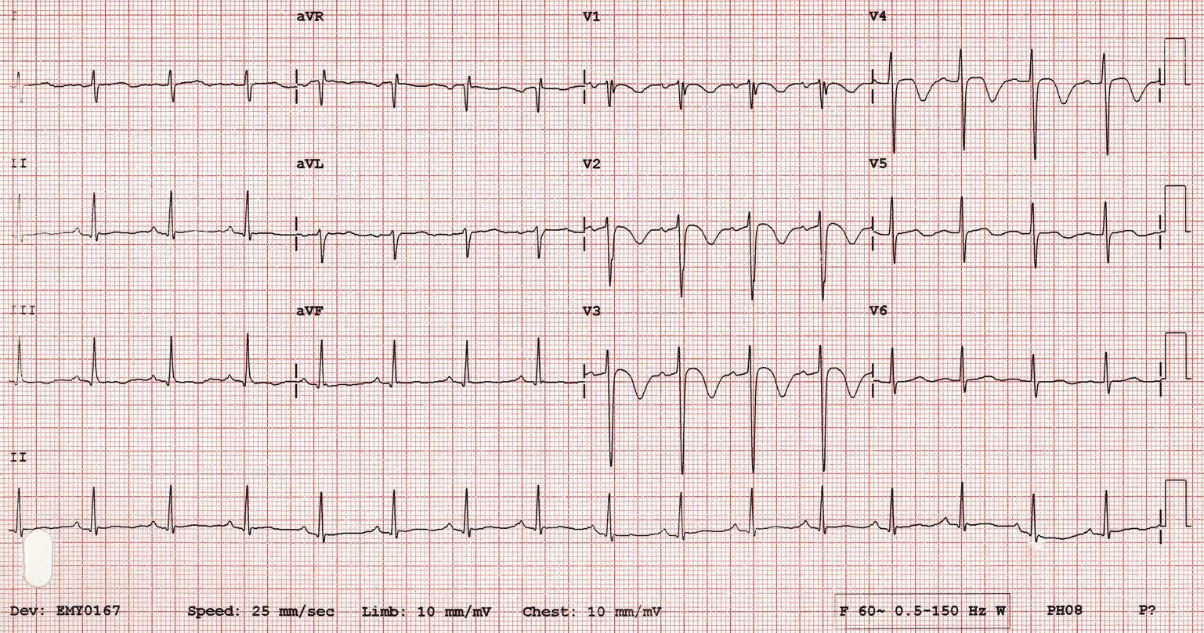
ECG 1

Slide 17
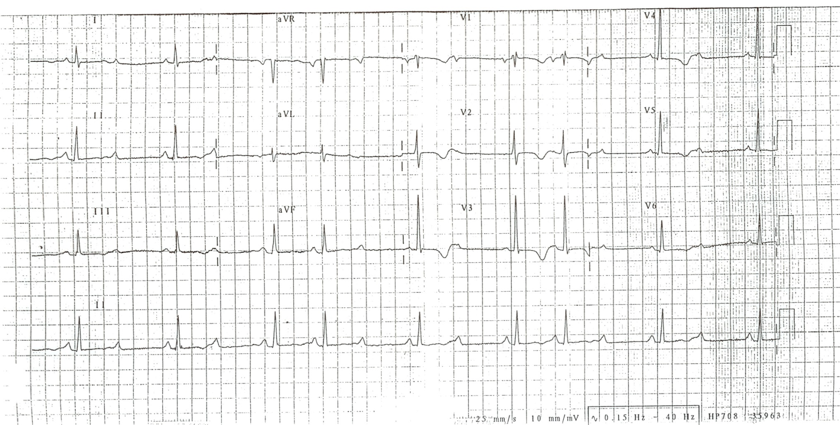
ECG 2

Slide 18
Diagnosis ?

Slide 19
Diagnosis
ECG 1: Wellens’ Syndrome Type 1
  T waves deeply and symmetrically inverted
ECG 2: Wellen’s Syndrome Type 2
  Biphasic T waves – initially positive then negative deflection
Critical proximal LAD stenosis
High risk of infarction within next 2-3 weeks
Admit cardiology even if painfree and troponin normal

Slide 20
Mr B
60 year old
Central crushing chest pain started 60 mins ago
No relief from GTN given by paramedics
Grey and clammy looking
SOB

Slide 21
Further Information …
PMHx: smoker, overweight
Meds: nil regular, NKDA
FMHx: nil
Obs: P100 BP 190/100 RR 20 SaO2 96%
Exam: Chest clear, no evidence of pulmonary oedema, no radial-femoral delay.

Slide 22
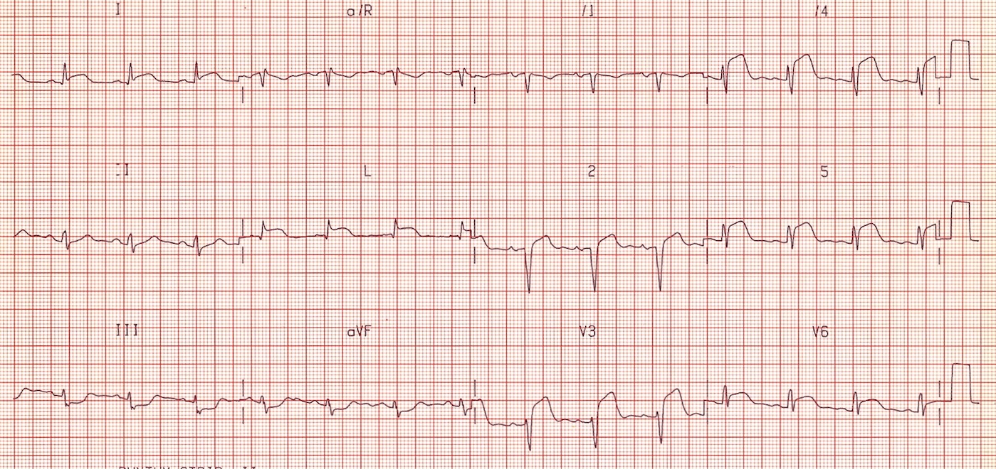
ECG

Slide 23
Diagnosis ?

Slide 24
STEMI

Slide 25
STEMI
Pathophysiology?
Clinically?
Risk Factors?

Slide 26
STEMI
ECG shows
  ST elevation ≥ 2mm in two or more contigous chest leads (V1-V4)
  ST elevation ≥ 1mm in two or more other contigous leads (I, II, III, AVL, AVF, V5, V6)
  New LBBB with strong clinical suspicion of MI
  True posterior MI

Slide 27
Reperfusion options
1. Primary percutaneous coronary intervention
  Within 12hours
2. Thrombolysis
  Increase of 1.6% mortality per hour of delay per every 1000 treated
3. Rescue PCI within 12 hours when apparent failure to reperfuse the infarct-infected artery.

Slide 28
Thrombolysis
STEMI
Within 12 hours of onset of pain
No contra-indications
Verbal consent: Approximately 1% risk of stroke and 4% risk of major non-cerebral haemorrhage but risks are outweighed by benefits.
Reteplase 10 units IV injection followed by further 10 units IV injection at 30 mins

Slide 29
Thrombolysis – How to cont …
Aspirin 300mg
Clopidogrel 300mg
Enoxaparin 30mg IV
  Only STEMI patients and only if <75 years, >60kg and normal renal function
Enoxaparin 1mg/kg SC BC
High flow oxygen
  If SpO₂ <94% an no risk of hypercapnic respiratory failure
Continuous ECG monitoring
Chest xray

Slide 30
Thrombolysis Contraindications
Suspected aortic dissection or pericaritis
Active internal bleeding
Haemorrhagic CVA/SAH/intracranial lesion
Embolic CVA within 3 months
Major trauma/head injury within 3 weeks
Major surgery within 14 days
GI bleed within 14 days
Internal organ biopsy/large arterial puncture within 12 weeks
Known bleeding disorder
Oral ant-coagulant therapy INR>2
Prolonged (>10mins) or traumatic CPR
Acute pancreatitis/active peptic ulcer
Diabetic proliferative retinopathy
Pregnancy or within 1 week post-partum
BP > 180/110

Slide 31
Driving license restrictions
Class I (private car and motorcycle)
  Angina: stop if pain at rest, recommence driving once symptoms controlled*
  ACS: 1/52 post successful angioplasty otherwise 4/52 restriction*
  Arrhythmia: cease driving only if arrhythmia has or is likely to incapacitate person*
Class II entitlements (LGV/ PCV)
  All patients with ACS are barred from driving for at least six weeks. Relicensing may be permitted thereafter provided exercise requirements can be met.
* DVLA does not need to be informed

Slide 32
Mr C
A 60 year old man comes to the Emergency Department with shortness of breath. He also complains of pleuritic chest pain. There are no features of pneumonia so you consider pulmonary embolism. Thinking about pulmonary embolism, which of the following is the most common ECG finding in patients who have pulmonary emboli?
  Atrial fibrillation
  Sinus tachycardia
  S1Q3T3
  RBBB
  LBBB

Slide 33
Mr C
A 60 year old man comes to the Emergency Department with shortness of breath. He also complains of pleuritic chest pain. There are no features of pneumonia so you consider pulmonary embolism. Thinking about pulmonary embolism, which of the following is the most common ECG finding in patients who have pulmonary emboli?
  Atrial fibrillation
  Sinus tachycardia
  S1Q3T3
  RBBB
  LBBB

Slide 34
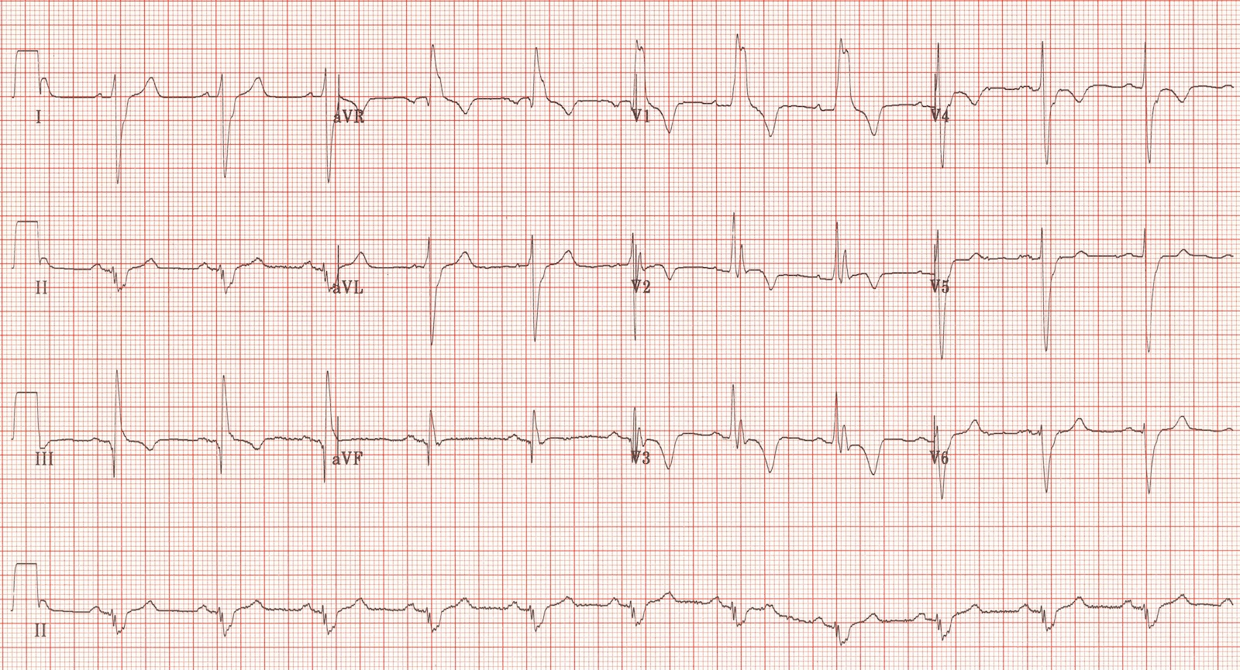
S1Q3T3

Slide 35
Mr C
2. Which of the following statements about D-Dimer test is correct?
  A negative D-Dimer can reliability exclude a PE in a patient with a low pre-test clinical probability.
  A positive D-Dimer confirms PE
  Systemic infection reduces D-Dimer

Slide 36
Mr C
2. Which of the following statements about D-Dimer test is correct?
  A negative D-Dimer can reliability exclude a PE in a patient with a low pre-test clinical probability.
  A positive D-Dimer confirms PE
  Systemic infection reduces D-Dimer
Notes:
PERC score: no need to measure D-dimer if ALL negative
age greater than or equal to 50
HR >100
Sao2 (room air) < 94%
current haemoptysis
oestrogen use
previous VTE
recent Sx or trauma within 4/52
unilateral leg swelling
Canadian Score
clinical features DVT 3.0
Recent immobility/Sx 1.5
Active cancer 1.0
Hx VTE 1.5
Haemoptysis 1.0
Resting HR >100 1.0
PE as likely or more 3.0
likely than DDx
Score Pre-test probability of PE
<2 low
2-6 medium
>6 high

Slide 37
Mr C
3. Which of the following is the most common CXR finding in patients with pulmonary embolism?
  Kerley B lines
  Small pleural effusion
  Normal CXR
  Wedge shaped pulmonary infarct
  Apical shadowing

Slide 38
Mr C
3. Which of the following is the most common CXR finding in patients with pulmonary embolism?
  Kerley B lines
  Small pleural effusion
  Normal CXR
  Wedge shaped pulmonary infarct
  Apical shadowing

Slide 39
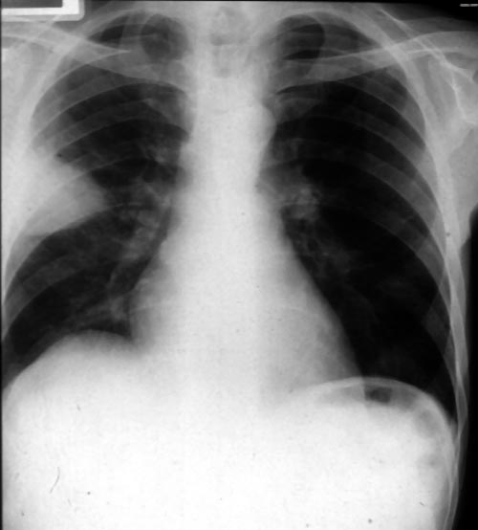
Wedge shaped Pulmonary Infarct

Slide 40
Mr C
4. The patient then tells you that he has a history of chronic obstructive pulmonary disease. But there are no features of an infective exacerbation and you still suspect that he may have a pulmonary embolism. Which one of the following tests would you ask for next?
  V/Q scan
  CTPA
  USS doppler of legs
  Echocardiogram

Slide 41
Mr C
4. The patient then tells you that he has a history of chronic obstructive pulmonary disease. But there are no features of an infective exacerbation and you still suspect that he may have a pulmonary embolism. Which one of the following tests would you ask for next?
  V/Q scan
  CTPA
  USS doppler of legs
  Echocardiogram

Slide 42
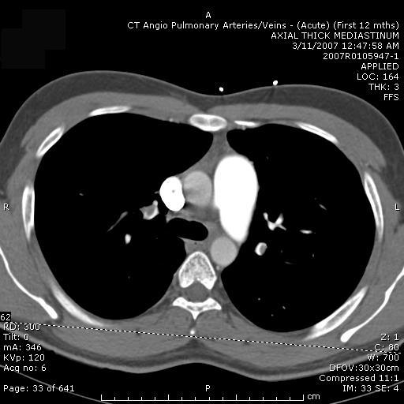
CTPA showing saddle embolism

Slide 43
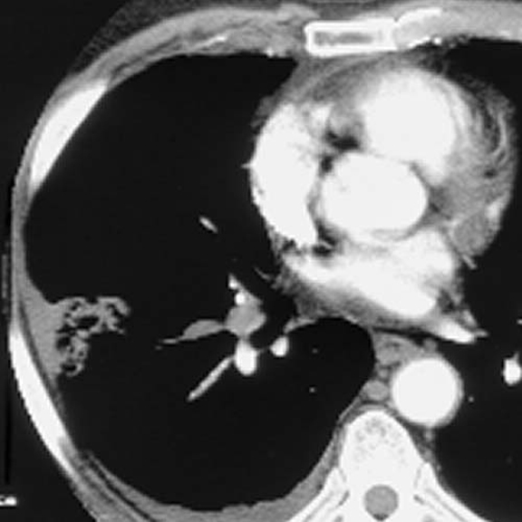
Wedge infarct

Slide 44
Mr C
5. While you are looking at the scan the nurse calls for help. The patient has got worse. He is now very short of breath and his blood pressure has fallen to 80/50 mm Hg. There is no other obvious cause for his hypotension besides the pulmonary embolism. What is the best course of action in this circumstance?
  Commence IV heparin
  Administer LMWH
  Administer thrombolytic agent

Slide 45
Mr C
5. While you are looking at the scan the nurse calls for help. The patient has got worse. He is now very short of breath and his blood pressure has fallen to 80/50 mm Hg. There is no other obvious cause for his hypotension besides the pulmonary embolism. What is the best course of action in this circumstance?
  Commence IV heparin
  Administer LMWH
  Administer thrombolytic agent
Notes:
PE with hypotension: may be beneficial, one small badly designed trial showed benefit of lysis vs heparin
PE and Cardioresp arrest: most evidence for benefit of lysis over heparin. This group already has a high mortality and often cause is responsive to lysis.
PE and RV dysfunction: some studies showed improvement in RV function but benefit generally outweighed ny risks of haemorrhage. Can be considered on individual basis.

Slide 46
Mr C
6. You decide to give a thrombolytic. Which of the following agents would you advise?
  Streptokinase
  Alteplase

Slide 47
Mr C
6. You decide to give a thrombolytic. Which of the following agents would you advise?
  Streptokinase
  Alteplase 50mg bolus IV
Notes:
No single agent or regimen has been shown to be more effective than any other, though the theoretical risk of worsening hypotension with streptokinase in patients with circulatory compromise suggests other thrombolytic agents may be preferable.
Alteplase 10mg IV stat followed by 90mg IV infusion over 2 hours

Slide 48
Mr C
7. Which of the following is a risk factor for the development of intracranial bleeding following thrombolysis?
  Young age
  Female sex
  Low dose of thrombolytic drug
  Chronic hypotension

Slide 49
Mr C
7. Which of the following is a risk factor for the development of intracranial bleeding following thrombolysis?
  Young age
  Female sex
  Low dose of thrombolytic drug
  Chronic hypotension

Slide 50
Mr C
Risk factors associated with intracranial bleeding:
Increasing age (0.4% at <65 years and 2.1% at >75 years)
Increasing dose of thrombolytic
Chronic hypertension
Female sex
Low body mass (with weight <70 kg being associated with a fourfold increase)
Pulmonary catheterisation
Notes:
The risk factors associated with intracranial bleeding are
Increasing age (0.4% at <65 years and 2.1% at >75 years)
Increasing dose of thrombolytic
Chronic hypertension
Female sex
Low body mass (with weight <70 kg being associated with a fourfold increase)
Pulmonary catheterisation.53 55

Slide 51
Mr C
9. He improves quickly and is started on heparin and warfarin. But six weeks later he comes back to hospital as he is confused. He undergoes a CT brain scan. What is the most likely diagnosis?
  Extradural haematoma
  Chronic subdural haematoma
  Subarachnoid haemorrhage
  Normal Scan
  Acute on chronic subdural haematoma

Slide 52
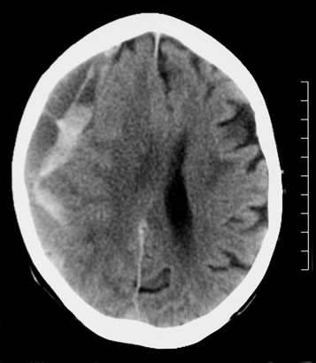

Slide 53
Mr C
9. He improves quickly and is started on heparin and warfarin. But six weeks later he comes back to hospital as he is confused. He undergoes a CT brain scan. What is the most likely diagnosis?
  Extradural haematoma
  Chronic subdural haematoma
  Subarachnoid haemorrhage
  Normal Scan
  Acute on chronic subdural haematoma

Slide 54
Mr C
9. He improves quickly and is started on heparin and warfarin. But six weeks later he comes back to hospital as he is confused. He undergoes a CT brain scan. What is the most likely diagnosis?
  Extradural haematoma
  Chronic subdural haematoma
  Subarachnoid haemorrhage
  Normal Scan
  Acute on chronic subdural haematoma
Notes:
There is an acute on chronic right subdural collection with a depth of at least 2.5 cm. There is associated oedema of the right cerebral hemisphere with an approximately 1 cm midline shift to the left. This is an acute on chronic subdural haemorrhage.

Slide 55
Mr D
18 year old
Recent coryzal illness
Sharp retrosternal chest pain
PMHx: nil
Meds: nil
T 38.5
HR 120 bpm
Pericardial rub

Slide 56
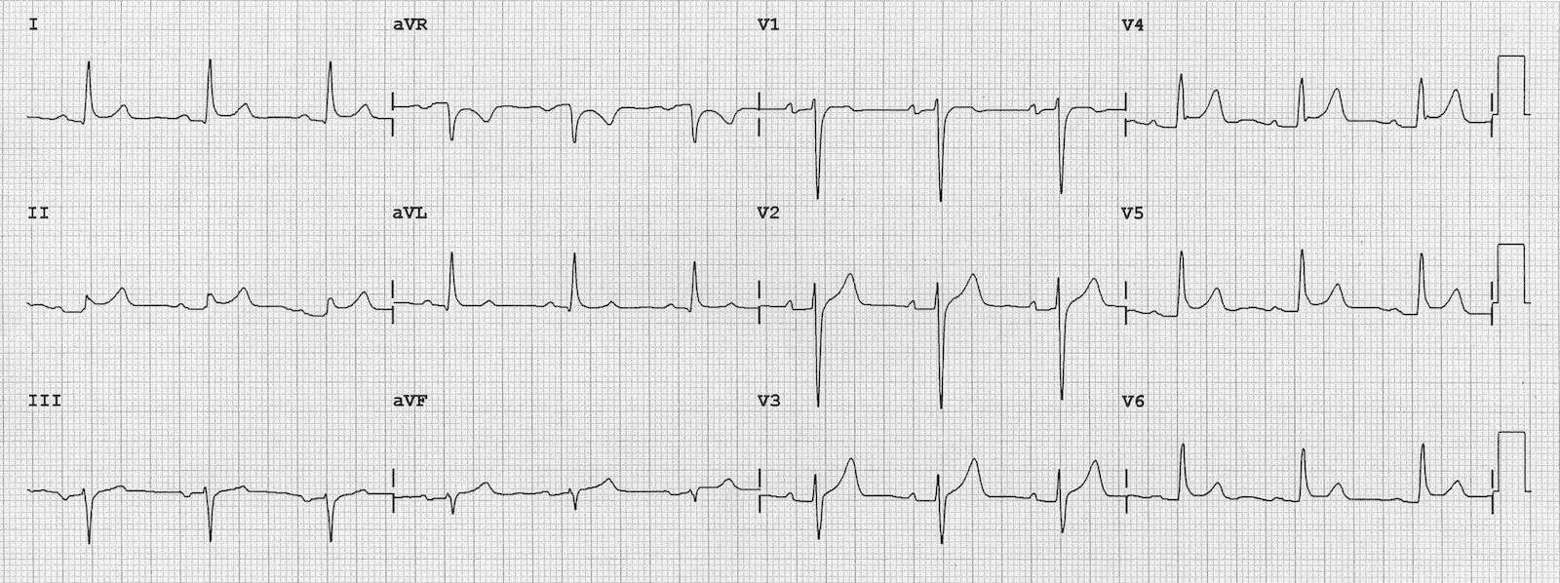
ECG

Slide 57
Diagnosis ?

Slide 58
Pericarditis

Slide 59
Pericarditis
Tend to be young
Sharp chest pain, worse on inspiration, may ease with sitting forward, usually retrosternal
Tachycardia, tachypnoea, pericardial rub (left sternal edge), fever
Causes:
  Post viral illness
  Post myocardial infarction
  Less common: connective tissue disease, uraemia, malignancy TB
Notes:
The pericardium is composed of the parietal pericardium (an outer fibrous layer) and the visceral pericardium (an inner serous membrane made of a single layer of mesothelial cells). The visceral pericardium is attached to the epicardial fat and reflects back on itself to form the parietal pericardium. The pericardium normally contains as much as 50 mL of an ultrafiltrate of plasma. Drainage occurs via the thoracic duct and the right lymphatic duct into the right pleural space.
In most cases of acute pericarditis, the pericardium is acutely inflamed and has an infiltration of polymorphonuclear (PMN) leukocytes and pericardial vascularization. Often, the pericardium manifests a fibrinous reaction with exudates and adhesions. The pericardium may develop a serous or hemorrhagic effusion. A granulomatous pericarditis occurs with tuberculosis, fungal infections, rheumatoid arthritis (RA), and sarcoidosis

Slide 60
Pericarditis
Treatment
  Symptomatic: NSAIDs, aspirin post STEMI, steroids only if indicated for underlying condition
  Pericardiocentesis if tamponade or purulent pericarditis
  Surgery if not responding to medical treatment

Slide 61
Mr E
55 year old male
Central crushing chest pain radiating into back
Syncope episode at home
PMHx: hypertension
Meds: B-Blocker

Slide 62
Mr E
O/E:
  Pale, sweaty
  Hypertensive
  Aortic regurgitation
ECG – inferior/posterior infract (RCA)
CXR – small pleural effusion

Slide 63
Diagnosis ?

Slide 64
Aortic Dissection

Slide 65
Aortic Dissection
Clinical features:
  Acute myocardial infarction (inf/post – right coronary aryery), aortic regurg, absent/weak pulses. Pericardial effusion, LVF, hypo/hypertension, haemothorax/pleural effusion, adbominal pain (mesenteric artery), dysphagia
Neurological features: (20% of patients)
  Syncope/LOC from hypotension
  Hemiplegia (carotid artery dissection)
  Paraplegia (spinal artery)

Slide 66
Aortic Dissection
Risk factors:
  Pregnancy
  Marfan’s syndrome
  Turner’s syndrome
  Coarctation of aorta
  Bicuspid aortic valve
  Smoking
  Hypercholesterolaemia
  Vasculitic disorders
  Cocaine abuse

Slide 67
Aortic Dissection
Early senior EM involvement
CXR (low sensitivity and specificity)
  Widened mediastinum
  Widening of aortic knuckle
  Deviation of trachea
  Pleural effusion
Further imaging
  MRI
  CT thorax
  Echocardiography

Slide 68
Aortic Dissection
Treatment
  Controlled hypotension (100-120mm Hg)
  IV beta-blockers (metoprolol, labetalol) reduce blood pressure and reduce the force of ventricular contraction
  Vasodilators (sodium nitroprusside) may be added to beta-blockers but not to be used along as increase force of LV contraction (NOT if pregnant)
  Thoracic surgery

Slide 69
Chest pain and trauma
May be obvious or occult trauma (eg. Domestic abuse, alcohol)
Focused history including medications (eg. Warfarin)
Careful examination including SpO₂, RR, auscultation, percussion
CXR if appropriate (fractured ribs/haemothorax)
Adequate analgesia
Discharge advice

Slide 70
Summary
Chest pain is a time critical condition
Focused history and examination
ECG
Appropriate Imaging eg. CXR (eGFR if contrast)
Senior help early
Treat life threatening conditions in the ED

Slide 71
Questions?

